Slide 1


Pub/Sub as an RPC Backbone
Rebuilding gRPC's patterns on NATS with CloudEvents and Tower
Christopher Coco
Software Infrastructure Lead, Verrus, LLC
verrusdata.com

Slide 2


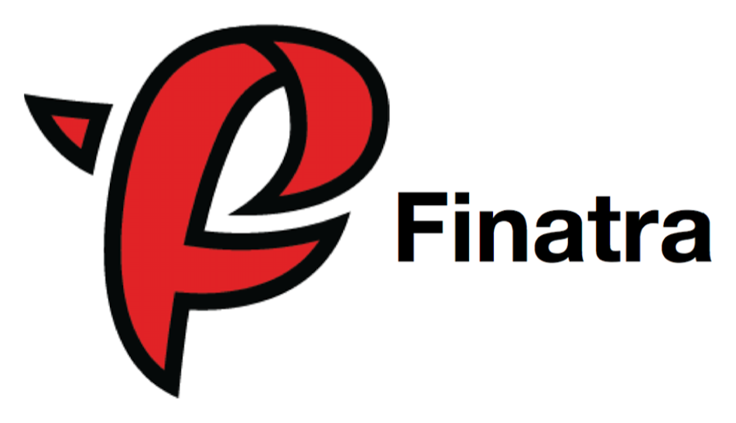


HI, I'M
2012-2022
Christopher Coco
Twitter
Principal Software Engineer
Platform Infrastructure
Software Infrastructure Lead, Verrus, LLC
2023-
background transport-agnostic RPC
Software Infrastructure Lead
The world’s most flexible and sustainable datacenters.
this talk RPC on pub/sub
github.com/cacoco

Slide 3


Two networking stacks
Your backbone is a broker. Then someone needs an RPC.
gRPC world
Broker world
HTTP/2 connections
NATS subjects
bridges?
client-side load balancing
queue groups
name resolution
JetStream, KV
mesh sidecars, proxies
leaf nodes, accounts
Two routing systems that don't know about each other.

Slide 4
What if the broker IS the transport?
gRPC
broker
RPC
broker
today
what if

Slide 5
Verrus: datacenters that flex
The world’s most flexible and sustainable datacenters
SHOCK ABSORBER FOR THE GRID
PRODUCTIVITY PER WATT
utility power that becomes productive compute power
grid demand
conventional
49%
Verrus
75%
Verrus draw from the grid
batteries
grid stress
modeled 70 MW case · Verrus, Beyond PUE
closed-loop cooling
battery backup, not diesel
quiet, near-zero emissions

Slide 6
Why Verrus runs on a broker
Data came first. RPC came second.
edge systems
publish
Unified Namespace
standardized subjects
power
UNS on NATS
clustering · leaf nodes · MQTT
subscribe
consumers
cooling
NATS
MQTT
batteries
IT
service
request / reply
service
One backbone for telemetry and RPC?

Slide 7
“flexible RPCs”
gRPC's programming model, with the broker as one of the transports
Typed RPC
from Protobuf
gRPC semantics
deadlines · status · tracing
NATS
in production
4 languages
Rust · Go · Python · Java

Slide 8
Three parts
From the RPC model, to NATS, to what rides with each RPC call
PART ONE
PART TWO
PART THREE
The RPC model
transport-agnostic
On NATS
RPC over NATS
What rides with each RPC call
a closer look
· the shape of “flexible RPCs”
· three transports
· Tower middleware
· the CloudEvents envelope
· subjects, replica, variant
· queue groups
· auth, discovery
· deadlines
· cancellation
· tracing

Slide 9

PART ONE
The RPC model
transport-agnostic: contract · transports · middleware

Slide 10
The shape of “flexible RPCs”
Protobuf in, typed facades out, transport underneath
.proto services + messages
source of truth
Why custom codegen?
Rust today
“flexible RPCs”
generated client + server, per language
thin, typed
.proto
.proto
service
+ gRPC or
Connect
service
core: messages · status codes · middleware
transport-agnostic
· · ·
any transport
transport interface
NATS
gRPC
HTTP
unary · one-way · stream

Slide 11
Three transports, three protocols
gRPC and HTTP come with one. NATS needed one.
NATS
gRPC
HTTP
production
keeps the core honest
keeps the core honest
PROTOCOL
PROTOCOL
PROTOCOL
custom
gRPC protocol
Connect protocol
subjects + headers + CloudEvents
PAYLOAD
PAYLOAD
PAYLOAD
protobuf Any
bare protobuf
bare protobuf
Same generated code, same service, tested on every transport, on every change

Slide 12
Tower: services wrapping services
Services are functions. Layers are functions on services.
service : Request → Future<Response>
layer : Service → Service
stack = logging ∘ retry ∘ timeout // still Service → Service
Finagle
Scala · filters wrap services
via Tokio
Tower
Rust · layers wrap services
Every layer sees only a request and a response, so none of them can depend on the transport.

Slide 13
Where the transport sits
At the edge of the stack, behind one generic message
CLIENT
SERVER
Message
client code
transport
router
Message → typed request
NATS
stack of layers
whatever the author adds
stack of layers
whatever the author adds
gRPC
innermost Tower service
typed request → Message
Message
HTTP
handler
handed to
one Tower service: Message → Message
Layers see a request, a response and a status. Never NATS, gRPC or HTTP.

Slide 14
PART TWO
On NATS
CloudEvents envelope · subjects · queue groups · auth · discovery

Slide 15
Why NATS gets an envelope
The CloudEvents envelope carries exactly what NATS lacks
HTTP provides
NATS provides
CloudEvents adds
a request path
a subject
RPC method + message type
a status channel
no typed error model
google.rpc.Status event in the payload
a header scheme
headers, no trace convention
traceparent / tracestate extensions
Content-Type header
opaque bytes
binary or JSON envelope, data field
NATS message
Content-Type header
CloudEvents envelope
source · type · traceparent · tracestate
data: your RPC message

Slide 16
The example: a load-shaping service
Hypothetical, in a datacenter. Three methods, all three call shapes
service LoadShaping {
rpc GetTarget(GetTargetRequest)
returns (Target)
unary
one request, one reply
rpc SetTarget(SetTargetRequest)
returns (google.protobuf.Empty)
one-way
returns Empty: no reply
rpc WatchLoad(WatchLoadRequest)
returns (stream LoadSample)
server streaming
one request, many frames
}
planner RPC client
calls
load-shaping service

Slide 17
Serving and calling it
Generated builders, one Tower stack per RPC method
SERVER
CLIENT
let server = LoadShapingServer::builder()
.get_target(
ServiceBuilder::new()
.layer(LoggingLayer::new("server"))
.timeout(Duration::from_secs(2))
.service_fn(get_target_handler),
)
.set_target(/* its own stack */)
.build();
let transport = NatsTransportServer
::new(url, conn, server.service_name())
.await?;
server.serve(transport).await?;
let transport = NatsTransportClient
::new(url, conn).await?;
let client = LoadShapingClient
::builder(transport, None)
.get_target(
ServiceBuilder::new()
.layer(LoggingLayer::new("client")),
Some(Duration::from_secs(2)), // deadline
)
.build();
let target = client
.get_target(GetTargetRequest { .. }).await?;

Slide 18
The subject is the address
rpc
replica-a
example-v1-LoadShaping
default
SetTarget
root
replica
service, dots → dashes
variant
method, one token
DEFINED ONCE, GENERATED EVERYWHERE
Rust
subject grammar
one definition
Rust server
rpc.replica-a.…LoadShaping.default.*
Go
Java
Go client
rpc.replica-a.…LoadShaping.default.SetTarget
Python

Slide 19
Two more slots: replica and variant
rpc . replica . service . variant . method
rpc
replica-a
…LoadShaping
default
SetTarget
baseline
NATS URL nats://…?replica=replica-a&variant=default
rpc
replica-a
…LoadShaping
canary
SetTarget
replica-a, canary variant
NATS URL nats://…?replica=replica-a&variant=canary
rpc
replica-b
…LoadShaping
default
SetTarget
new replica, default variant
NATS URL nats://…?replica=replica-b&variant=default

Slide 20
Load balancing: queue groups
One queue group per replica, service and variant
queue group = replica . service . variant
replica-a.…LoadShaping.default
instance 1
planner
(client)
NATS
instance 2
instance 2 ← picked
instance 3
replica-a.…LoadShaping.canary
canary instance

Slide 21
The subjects around an RPC
Data plane and control plane, and who receives each
DATA PLANE
planner
inst 1
inst 2
inst 3
PUBLISHED TO
SUBSCRIBED AS
request
….default.GetTarget
….default.*
queue group: one instance
reply
_INBOX.<unique>
_INBOX.<unique>
only the caller
CONTROL PLANE
cancel
….default.GetTarget.cancel
….default.*.cancel
every instance
stream control
….WatchLoad.control.<inst 2>.<stream>
….*.control.<self>.*
only its own instance

Slide 22
Auth: permissions are subjects
NATS over TLS with decentralized auth, scoped per service on clients and servers
TLS: server cert from a private CA decentralized auth: each user's JWT carries its permissions
grants built from the subject scheme
planner (client)
publish rpc.*.example-v1-LoadShaping.*.SetTarget
load-shaping service (server)
subscribe rpc.*.example-v1-LoadShaping.>
reply only to the requests it receives
Out of the box: NATS enforces both sides at the broker.

Slide 23
Discovery: the NATS services API
Every served RPC service answers $SRV.PING and $SRV.INFO
$SRV.INFO → example-v1-LoadShaping
service example.v1.LoadShaping
replica replica-a
variant default
methods GetTarget SetTarget WatchLoad
WHERE $SRV.PING HELPS
unary
planner
NATS
no subscriber
← no responders: UNAVAILABLE, immediately
one-way
planner
NATS
no subscriber
← publish succeeds, nobody handled it
$SRV.PING first. The client transport pings. No answer → UNAVAILABLE.

Slide 24
One unary call, end to end
GetTarget over NATS
queue group
planner (client)
GetTarget(req)
Tower layers
timeout · log
CloudEvents
encode
NATS
server 1
publish rpc.<replica>.example-v1-LoadShaping.default.GetTarget
server 2 ← picked
header request ID
rpc GetTarget(GetTargetRequest) returns (Target)
server 3
decode → typed Target
_INBOX.<unique> private reply
handler → reply
No responders? NATS says so immediately, and the client maps it to UNAVAILABLE.

Slide 25
A one-way call
SetTarget over NATS
queue group
planner (client)
SetTarget
Tower layers
timeout · log
CloudEvents
encode
NATS
server 1
publish rpc.<replica>.example-v1-LoadShaping.default.SetTarget
server 2
returns once published
$SRV.PING before the publish
server 3
server 3 ← picked
rpc SetTarget(SetTargetRequest) returns (google.protobuf.Empty)
✕
handler runs
no reply inbox, no response

Slide 26
PART THREE
What rides with
each RPC call
deadlines · cancellation · tracing

Slide 27
Deadlines: one absolute timestamp
Set once by the caller, honored by every hop
planner → GetTarget, timeout 2s → deadline header: now + 2s
just before
handler told to stop
grace window
client stops waiting
handler budget
t0
call sent
deadline
server replies
DEADLINE_EXCEEDED
An absolute deadline survives time queued in NATS, but assumes synchronized clocks.

Slide 28
Server-side cooperative cancellation
How a handler learns to stop: the deadline, shutdown, or the client cancelling
request deadline
fires just before it
Opt in
token fires → clean up → CANCELLED
cancellation token
one per call
shutdown
after the grace period
Ignore it
cut off anyway
client cancel
request ID on the cancel subject
Propagate
A → B → C: all stop at A's deadline

Slide 29
Shutdown and client cancellation
Two of the inputs that fire the cancellation token
PHASE 1
PHASE 2
SIGTERM
grace period
grace period ends
stop taking new requests
in-flight requests finish
cancel what's still running
CLIENT CANCEL
instance 1
no such request: ignores
planner
abandons the RPC
NATS
instance 2 · serving
token fires
instance 3
no such request: ignores
publish request ID
….default.GetTarget.cancel
Cancel lost? the deadline still ends the RPC

Slide 30
Tracing end to end
One trace across client, NATS hop, and server
CloudEvents envelope
traceparent · tracestate
client span
planner → GetTarget
server span
continues the caller's trace
extract: CloudEvents envelope, then headers
message headers
traceparent · tracestate
same W3C values, two carriers
OTLP → collector spans follow the OpenTelemetry RPC semantic conventions
Why two carriers? Interop. Peers and tools that don't speak CloudEvents still read W3C trace headers.

Slide 31
WRAPPING UP
Putting it
all together

Slide 32
Pub/sub RPC vs. gRPC
The whole trade, row by row
gRPC over HTTP/2
RPC on pub/sub (NATS)
Load balancing
client-side LB, proxy or mesh
● queue groups, built in
Discovery
DNS, xDS or a registry
● $SRV.PING / $SRV.INFO
Canary, isolation
mesh traffic splitting
● replica + variant subject tokens
Auth
TLS + interceptors you write
● NATS decentralized auth, per subject
Networking stacks
a second one beside NATS
● one: NATS
Deadlines
relative grpc-timeout
absolute; assumes synced clocks
Streaming
● native, including bi-directional
custom, server-side only
Client cancel
● native, over HTTP/2
custom cancel subject
Hops
● direct connection
always via NATS

Slide 33
The broker is the transport.
Protobuf
for the contract
CloudEvents
for the envelope
Tower (Rust)
for the middleware
NATS
for the transport
already in NATS
✓ routing
✓ load balancing
✓ delivery
✓ discovery
✓ auth

Slide 34

Thank you
Questions?
Christopher Coco · Verrus, LLC
christopher@verrusdata.com
TONIGHT · 7 TO 9 PM
NATS user meetup with Synadia
More questions, or a deeper dive: come find me there.

